Slide 1
FASTAPI Development using Python on Cloud
FastAPI with Agentic AI on Cloud

Slide 2
Overview of Alembic
Alembic provides for the creation, management, and invocation of change management scripts for a relational database, using SQLAlchemy as the underlying engine.
Usage of Alembic starts with creation of the Migration Environment. This is a directory of scripts that is specific to a particular application.
The migration environment is created just once and is then maintained along with the application’s source code itself. The environment is created using the init command of Alembic and is then customizable to suit the specific needs of the application.

Slide 3
Alembic Benefits
Version Control for Your Database: Alembic acts like "Git for your database schema," allowing you to track every change (e.g., adding a table, renaming a column) as an explicit, versioned step in a migration script. This provides a clear, auditable history of modifications.
Consistency Across Environments: It ensures that every developer, testing environment, and the production database uses the exact same schema evolution process. This eliminates "schema drift" and prevents issues caused by manual errors during deployment.
Safe Upgrades and Downgrades (Rollbacks): Each migration script contains instructions for both applying the changes (upgrade) and reversing them (downgrade). This provides a crucial safety net, allowing you to revert to a previous, stable state if a new release encounters problems.
Streamlined Collaboration: Each developer's schema changes are captured in migration files that are checked into the source code repository. Team members can easily pull the latest changes and run a single command to sync their local databases.
Automation and CI/CD Integration: Migrations can be easily integrated into Continuous Integration/Continuous Deployment (CI/CD) pipelines, automating the process of applying database changes during deployment. This makes releases more reliable and predictable.
Pythonic API and SQLAlchemy Integration: Migration scripts are written in Python, allowing developers to leverage the full power and readability of Python code. It works hand-in-hand with SQLAlchemy, the most popular Python ORM, and can automatically generate draft migration scripts based on model definitions.
Database Agnostic: Alembic supports all major databases that SQLAlchemy works with, including PostgreSQL, MySQL, and SQLite, making it a versatile choice for diverse projects.

Slide 4
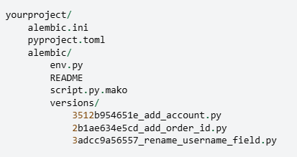
Directory Structure
Alembic.ini -> This is Alembic’s main configuration file which is generated by all templates.
Pyproject.toml – Alembic may store optionally project related configuration.
Yourproject – root of the application.
Alembic – The directory lives within the application source tree and source of migration.
env.py – part of generated environment so that the migration runs are entirely customizable.

Slide 5
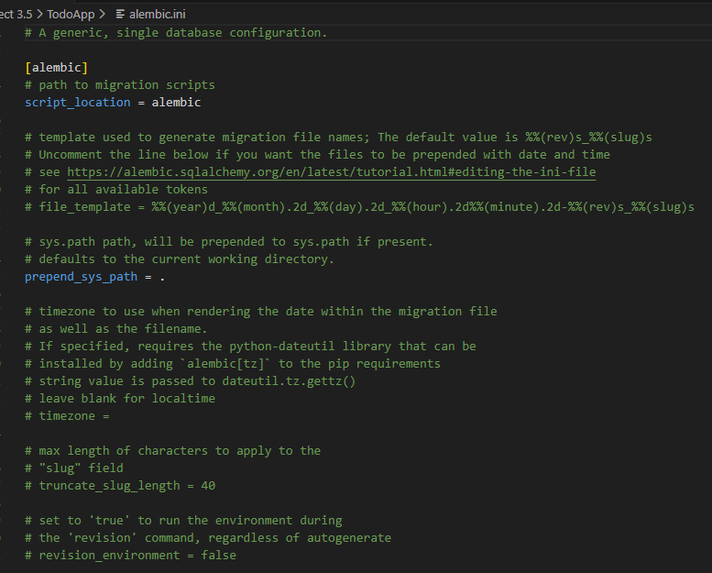
Alembic .ini file

Slide 6
Migration of FastAPI Apps to Azure
Azure App Service is a fully managed web hosting service that supports Python apps hosted in a Linux server environment.
CI/CD: Deploy continuously with GitHub Actions, Azure Pipelines, and more. Deploy predictably through staging environments.
High-density hosting savings: Run more applications on fewer VMs with the memory-optimized P*mv3 tiers and save up to 55% on predictable workloads with Azure savings plans and reserved instances.
Full isolation: Secure ingress and egress with Azure Virtual Network integration, or run fully isolated applications with App Service environments, using dedicated networking and VMs.
Line-of-business: Develop business applications easily with built-in authentication, Microsoft Graph, and connectors to your line-of-business applications.
Reliability: Robust SLA and zone redundancy features help disaster-proof your application.
Security and compliance: ISO, SOC, and PCI compliance meet the strictest requirements of large enterprises.

Slide 7
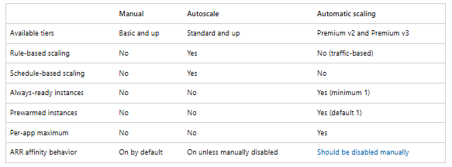
Azure App Service Scaling out Options

Slide 8
Deployment of FastAPI App with Azure
Pre-requisites
Python 3.10+
Azure Account
Configure a custom startup command that uses Gunicorn to run the asynchronous Uvicorn server, along with ensuring your dependencies are specified correctly.
Deployment can be done using the Azure CLI, Visual Studio Code extensions, or GitHub Actions.

